Slide 1
Problem Statement 1:
Tweet Classification
By,
TEAM: OkayXD
Prathmesh Deshmukh
Gavin Henry Lewis

Slide 2
Exploratory Data Analysis
Understanding the dataset.
Data Cleaning and removal of ‘NA’ values
Compressing the Variables and the Model:
Reducing the memory impact of the variables by compressing and converting the int types in python
This ‘memreduce’ function created reduces the memory used by the dataframe from 0.66 to 0.34 as seen in the notebook submitted.

Slide 3
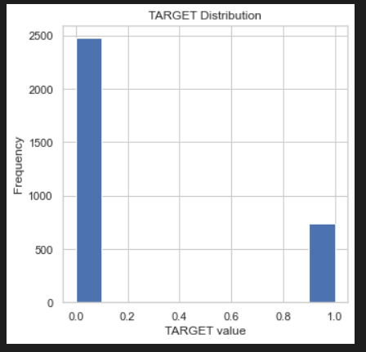
Data Visualization
Understanding the skew in the Target Variable.
Plotted the target variable to understand the distribution of target variable.
This plot was done with respect to the ‘Target’ variable.

Slide 4
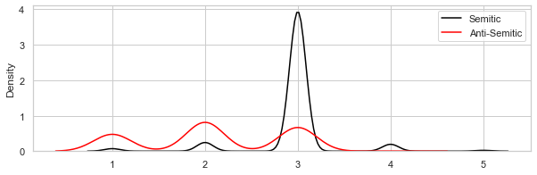
Data Visualization
2. Density Plots of the Numerical features:
Sentiment Rating:

Slide 5
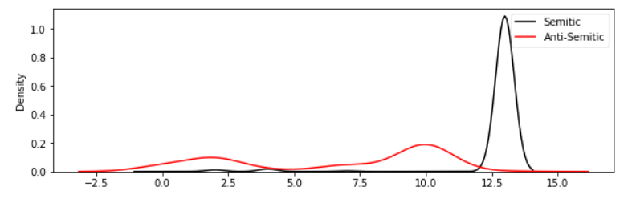
Data Visualization
2. Density Plots of the Numerical features:
b. IHRA Section:

Slide 6
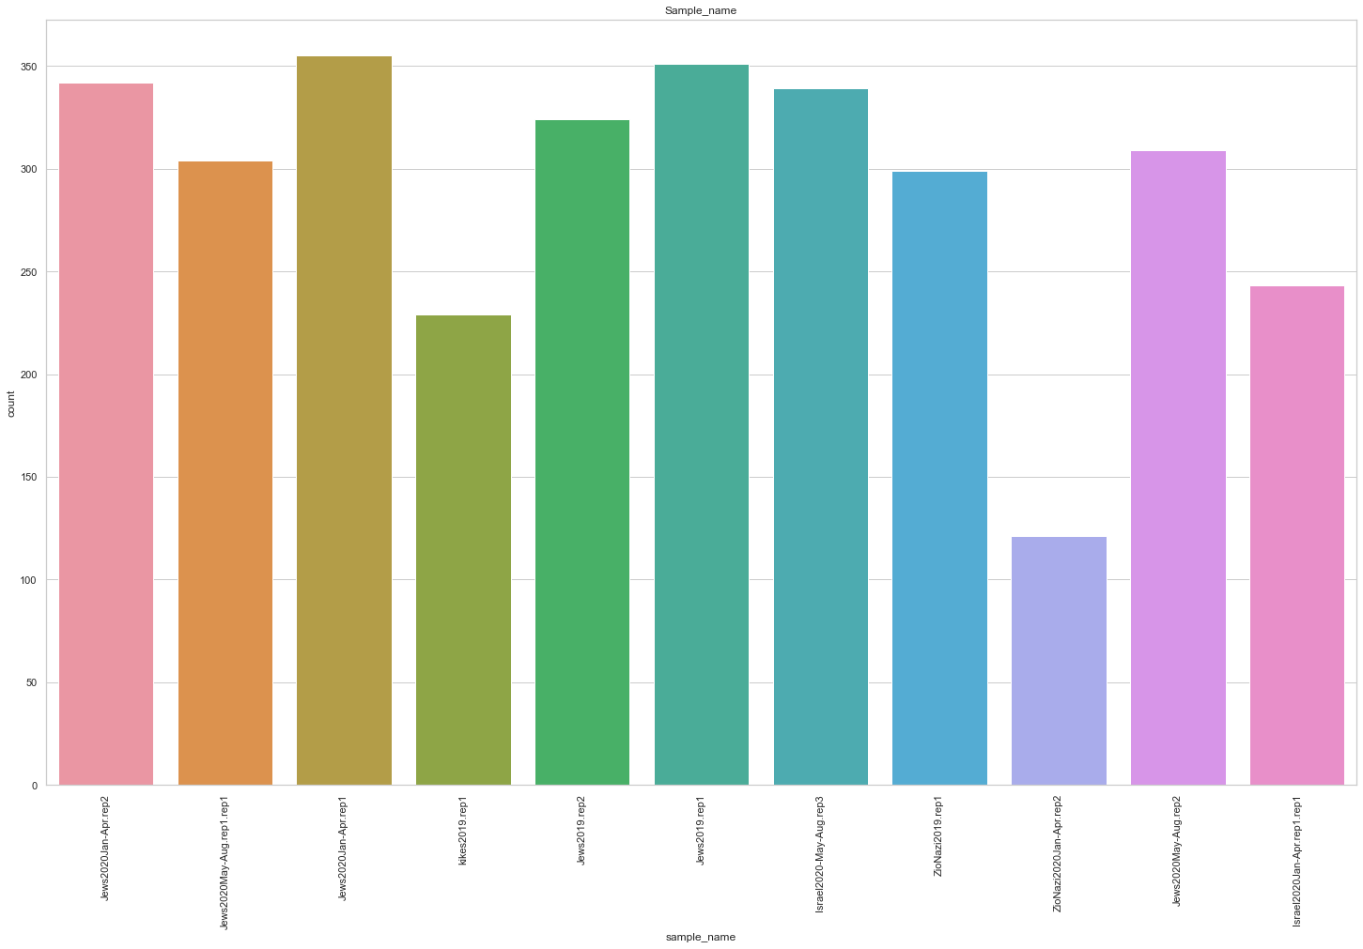
Data Visualization
3. Distribution of Categorical variables:
Distribution of Sample_name

Slide 7
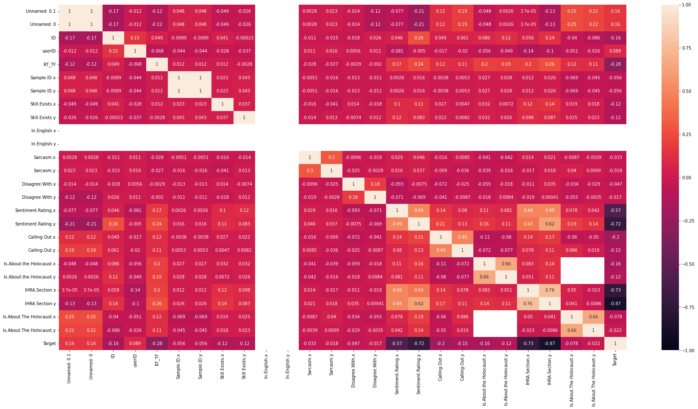
Correlation Matrix

Slide 8
Models Used
Conducted model training with the given processed data setwith the models:
XGBoost
SVD
Random Forest
KNN
The results are stored in the expLog variable in the code.

Slide 9
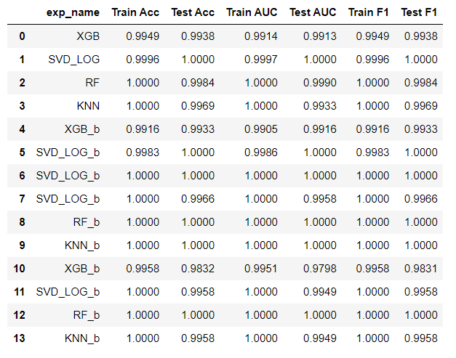
Experiment Log

Slide 10
Conclusion
From the experiment log we can conclude that Random Forest model performs better than other models considered in testing.
This is because he test AUC of this model is higher than all others on which tests were conducted.

